Slide 1
Olympics
File created on: 4/26/2021 7:04:36 PM

Slide 2
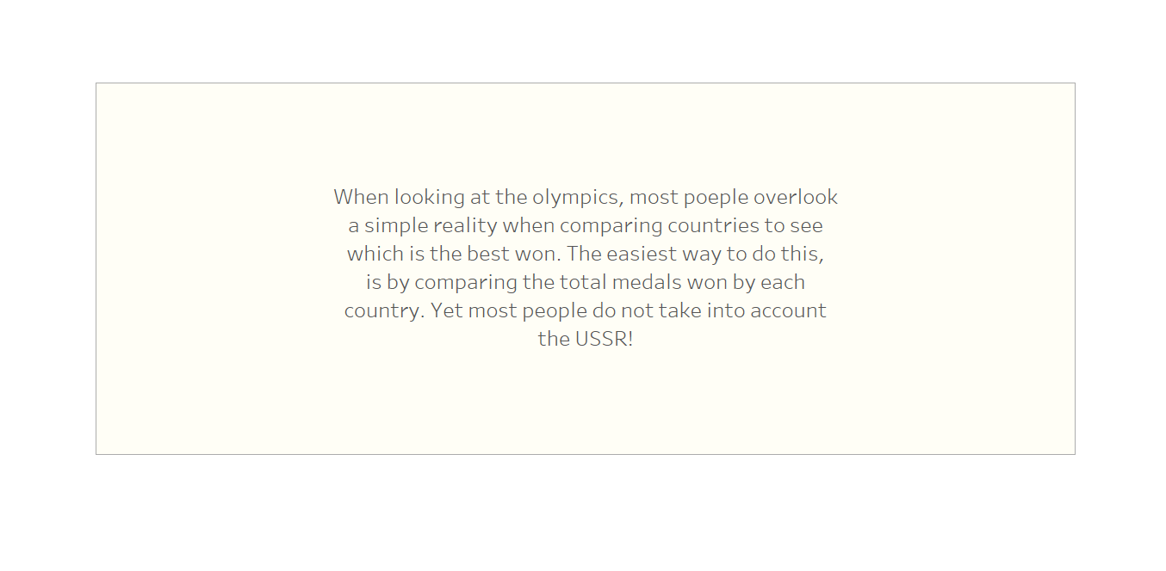

Slide 3
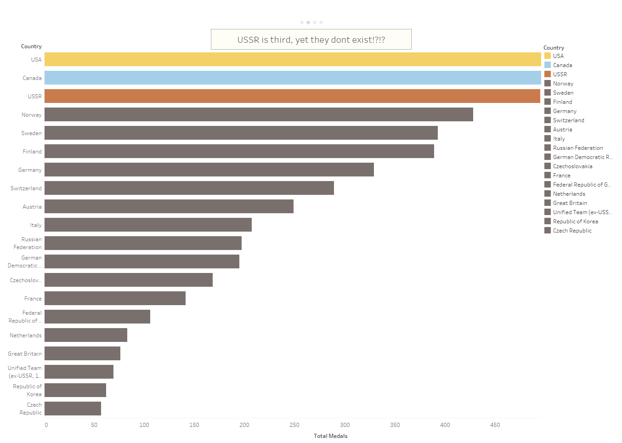

Slide 4
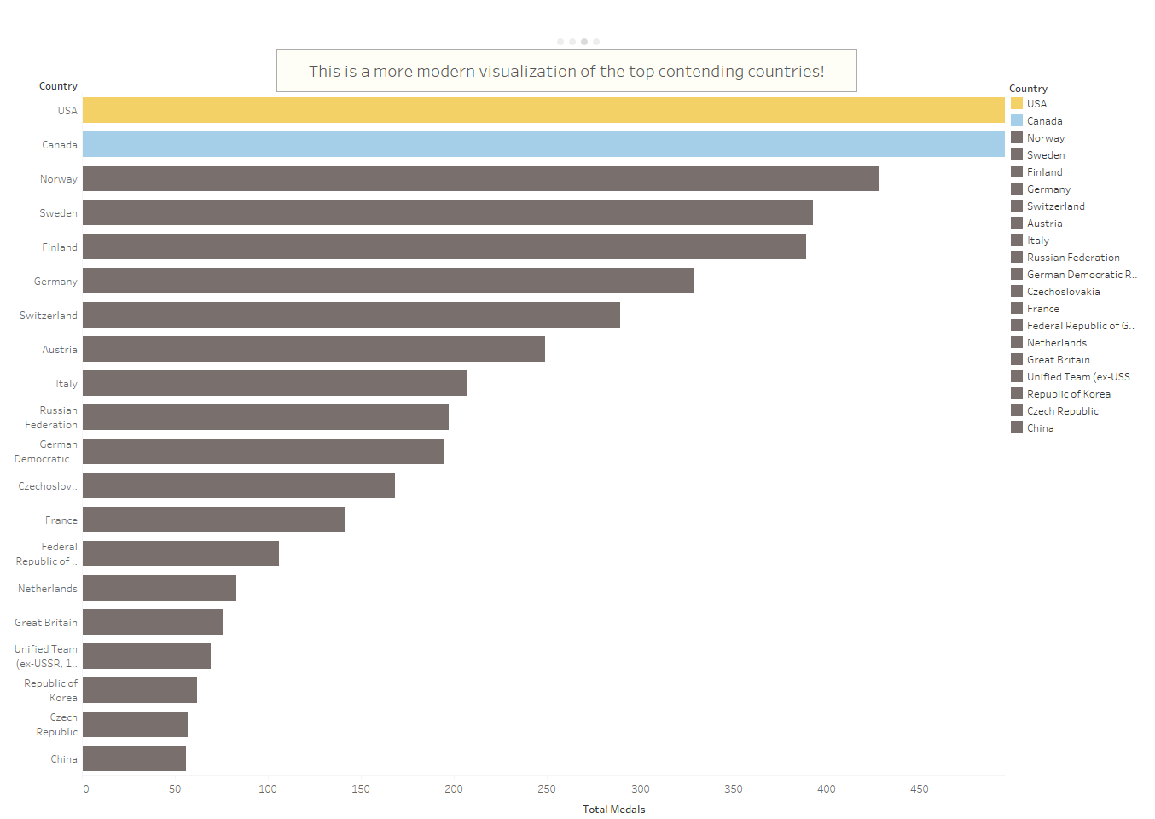

Slide 5
